Slide 1


AGENDA
01
Item 2
Item 3
Big Data
02
Hadoop

Slide 2
Introduction to Big data

Slide 3
Introduction to Big data
01
What is Big Data?
02
Characteristics of Big Data
Big Data
03
Types of Big Data
04
Tools and Applications of Big Data
05
Big Data Analytics & Stages

Slide 4


Slide 5
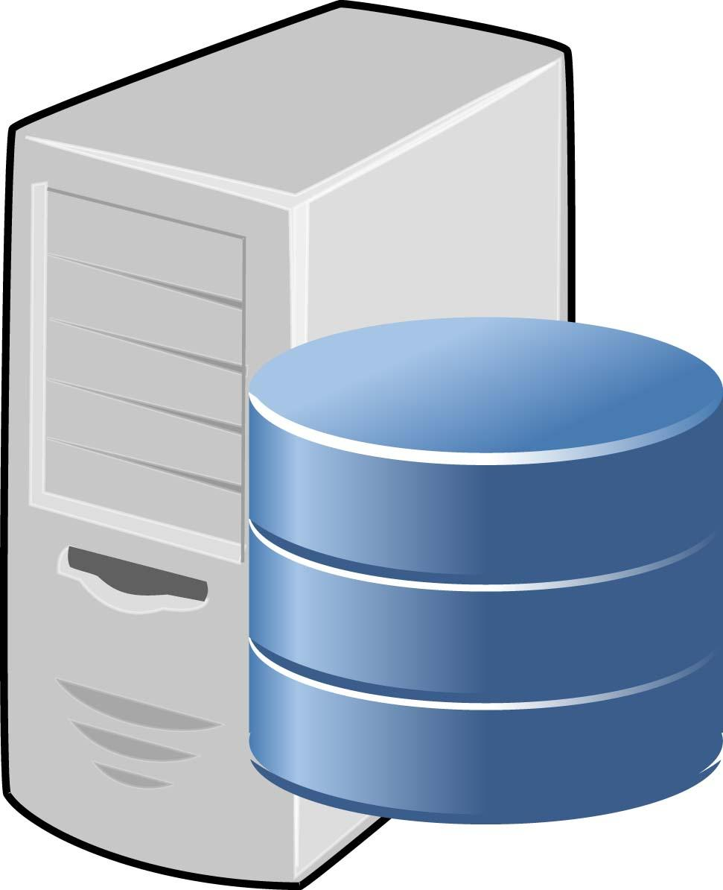
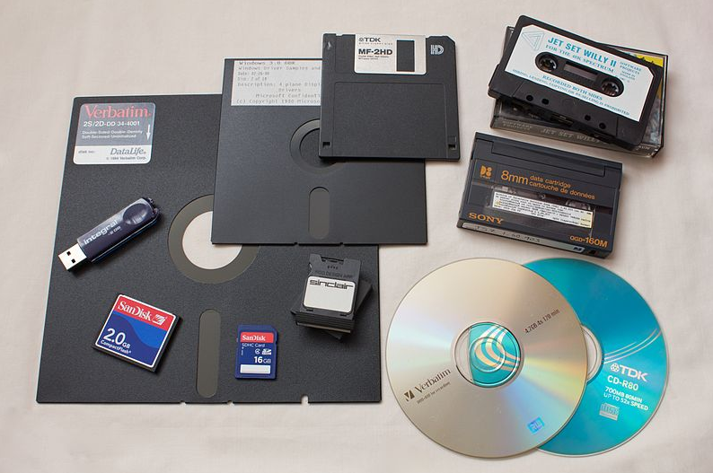
How Big Data came?

Slide 7

What is Data?
Data means simply we can say that Information

Slide 8

What is Big Data?
Big Data is also data but with a huge size. Big Data is a term used to describe a collection of data that is huge in volume and yet growing exponentially with time.

Slide 9


Slide 10
Types of Big Data
Structured
Organized Data
Ex: Excel Sheets, Database,
Unstructured
Unorganized Data
Comments, Videos, Posts
Semi Structured
Structured + Unstructured Data
Json Files, XML files

Slide 11
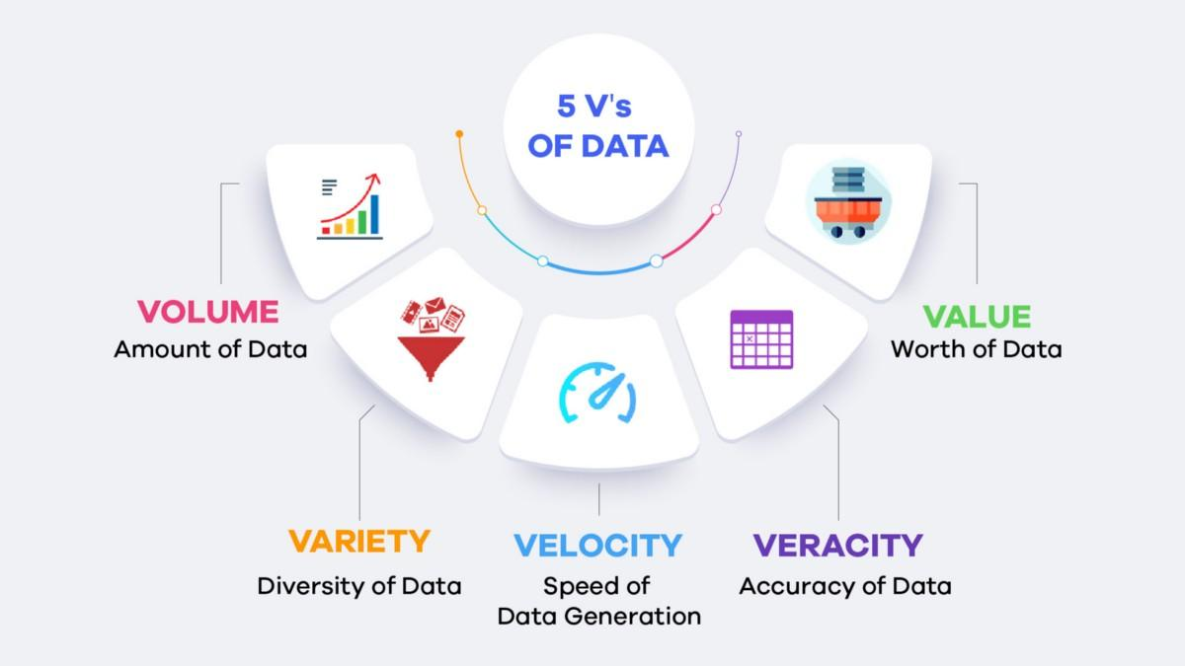
Characteristics Big Data

Slide 12
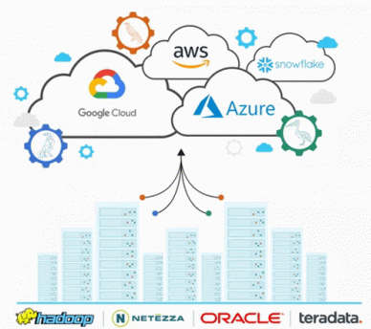
Tools in Big Data
Apache Spark
Apache Hadoop
Apache Flink
Google Cloud Platform
MongoDB
Sisense
RapidMiner

Slide 13

Applications of Big Data
Banking and Securities
Communications, Media and Entertainment
Healthcare Providers
Education
Manufacturing and Natural Resources
Government
Insurance
Retail and Wholesale trade
Transportation
Energy and Utilities

Slide 14
Big Data Analytics
Fraud Management Report, used in Banking Sectors to find the fraud transactions, hacking, unauthorized access to the account and so on.
Live Tracking Report which is generally used by Transport Sectors such as Meru, Ola, Uber, and Mega to track the vehicles, customer’s requests, payment management, emergency alert and to find the daily needs and revenues and so on.

Slide 15
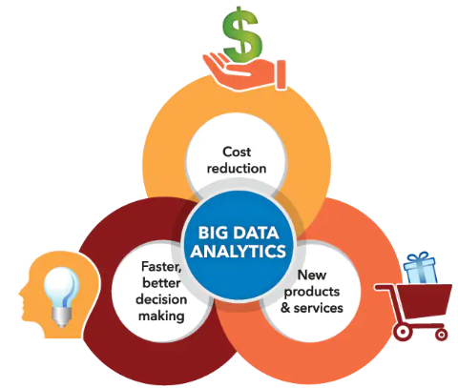
Why Big Data Analytics

Slide 16
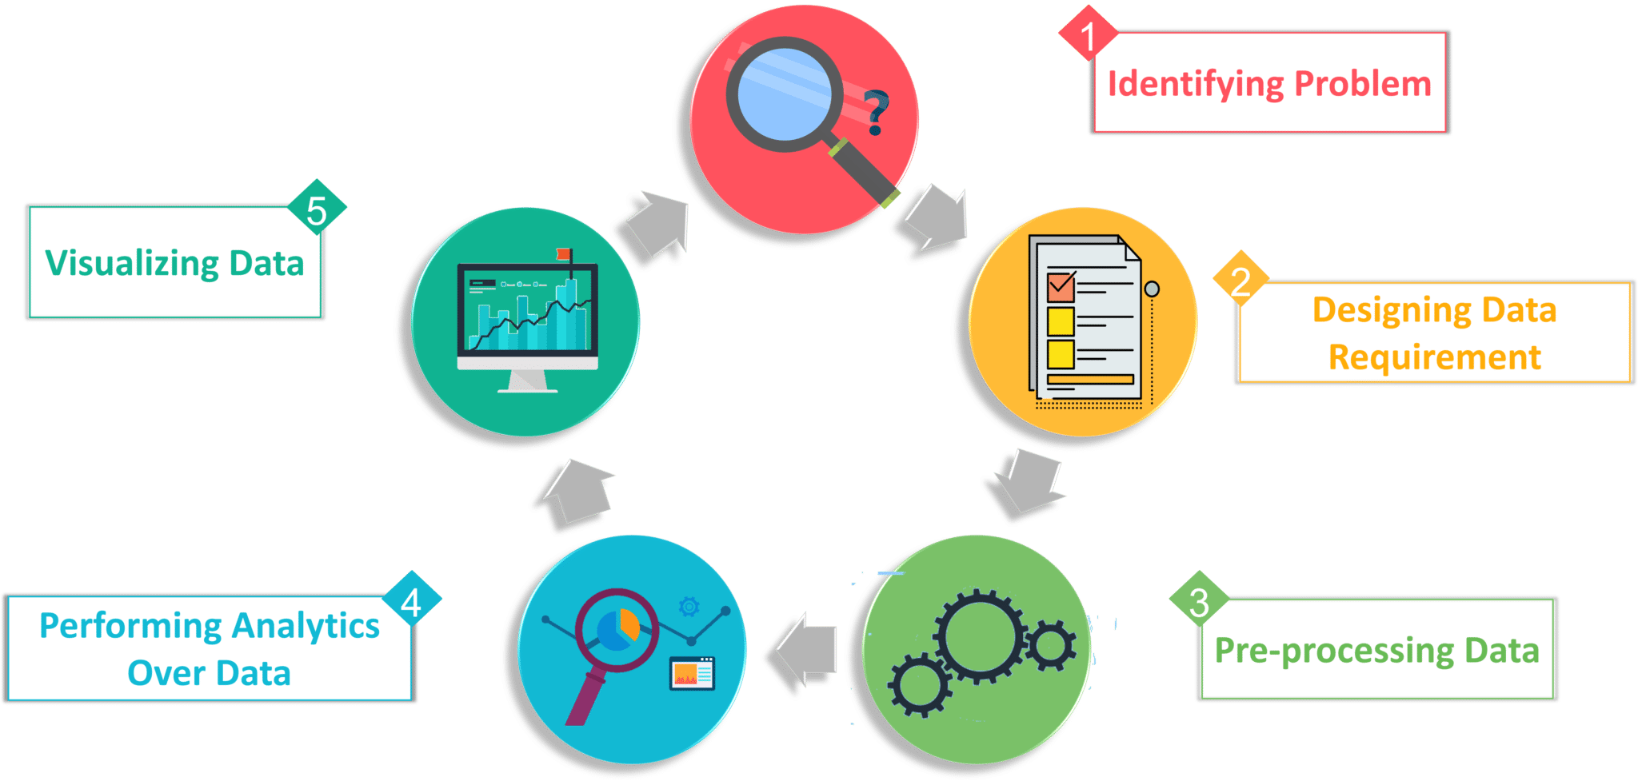
Stages Big Data Analytics

Slide 17
Introduction to Hadoop

Slide 18
Introduction to Hadoop
01
How Hadoop Started?
02
Hadoop
How Big Data Similar to Hadoop
03
How Hadoop Solving Big Data Problems
04
Understanding Hadoop in Detail
05
Features of Hadoop

Slide 19

How Hadoop Started?
Mike Cafarella & Doug Cutting want to build search engine system
To build That Search engine with 1 billion pages it may cost $35000/month

Slide 20
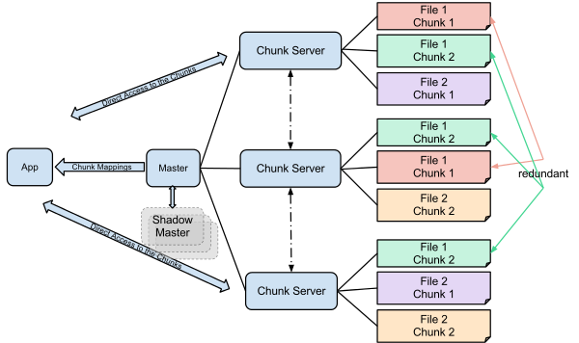
How Hadoop Started?
In 2003 GFS(Google Distributed File System) Introduced

Slide 21
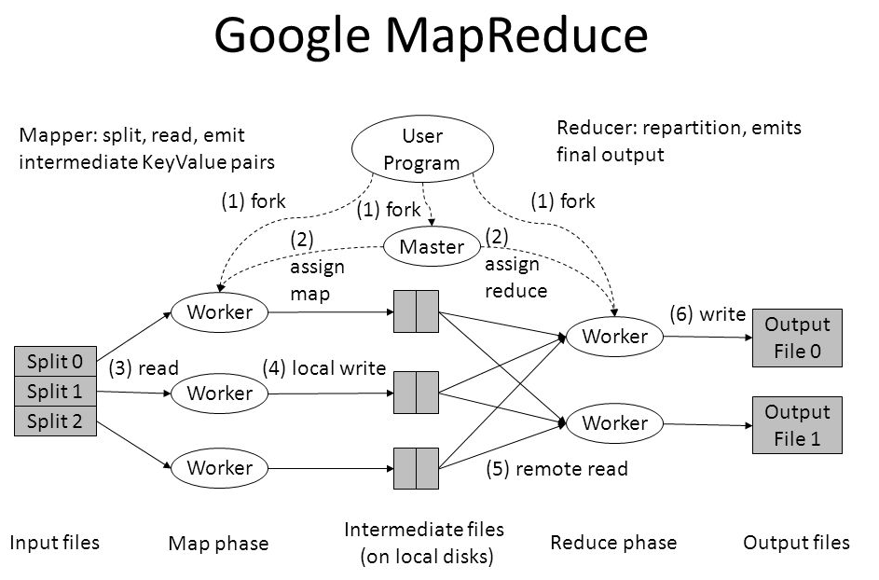
How Hadoop Started?
In 2004 Google again Introduced MapReduce

Slide 22
How Hadoop Started?
HADOOP = GFS + MapReduce
HADOOP = HDFS + MapReduce

Slide 23
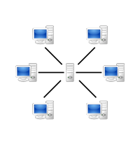
How Big Data Similar to Hadoop?
Traditional DB cannot handle large data
For Large Data Hadoop using distributed
Processing
Multiple processing units were installed to process data in parallel

Slide 24
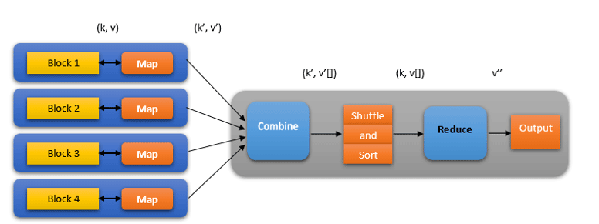
How MapReduce used?
Processing (Map Reduce) Phase
Distributing (HDFS)Phase

Slide 25
Parallel Processing
DATA

Slide 26
Parallel Processing
DATA

Slide 27
Parallel Processing
DATA
Slave Nodes

Slide 28
Parallel Processing
DATA
Slave Nodes

Slide 29
Parallel Processing
DATA
Slave Nodes
Intermediate Results

Slide 30
Parallel Processing
DATA
Slave Nodes
Intermediate Results

Slide 31
Parallel Processing
Master Node Merge gives Final Output
DATA
Slave Nodes
Intermediate Results

Slide 32

Big Data Problems
Problem 1: Storing Large amount of Data

Slide 33

Big Data Problems
Problem 2: Storing Different Types of Data

Slide 34
Big Data Problems
Problem 3: To process high amount of Data speed will decrease

Slide 35

How Hadoop Introduced
To Solve Storage and processing issues Hadoop created to components HDFS, YARN
HDFS- Store Data in Distributed Manner
YARN-Solve Processing issue by reducing process time
HDFS
Storage Layer
YARN
Resource Management Layer

Slide 36
What is Hadoop Exactly?
Open Source Software Framework used for storing and processing big data.
Hadoop Written in JAVA
Hadoop is one of the top project in APACHE Projects

Slide 37
How Hadoop Solve Big Data Problems?
Problem 1: Storing Large amount of Data , Hadoop used HDFS
HDFS- provides Distributed way to store huge data
DATA
(512MB)

Slide 38
How Hadoop Solve Big Data Problems?
Problem 1: Storing Large amount of Data , Hadoop used HDFS
HDFS- provides Distributed way to store huge data
128MB
128MB
DATA
(512MB)
128MB
128MB

Slide 39
How Hadoop Solve Big Data Problems?
Problem 1: Storing Large amount of Data , Hadoop used HDFS
HDFS- provides Distributed way to store huge data
128MB
128MB
DATA
(512MB)
128MB
128MB
Data Blocks

Slide 40
How Hadoop Solve Big Data Problems?
Problem 1: Storing Large amount of Data , Hadoop used HDFS
HDFS- provides Distributed way to store huge data
128MB
128MB
DATA
(512MB)
128MB
128MB
Data Blocks

Slide 41
How Hadoop Solve Big Data Problems?
Problem 1: Storing Large amount of Data , Hadoop used HDFS
HDFS- provides Distributed way to store huge data
128MB
128MB
DATA
(512MB)
128MB
128MB
Data Blocks
Stored in Different Data Nodes

Slide 42
How Hadoop Solve Big Data Problems?
Problem 1: Storing Large amount of Data , Hadoop used HDFS
HDFS- provides Distributed way to store huge data
128MB
128MB
DATA
(512MB)
128MB
128MB
Data Blocks
Stored in Different Data Nodes

Slide 43
How Hadoop Solve Big Data Problems?
Problem 1: Storing Large amount of Data , Hadoop used HDFS
HDFS- provides Distributed way to store huge data
128MB
Master Node Merge gives Final Output
128MB
DATA
(512MB)
128MB
128MB
Data Blocks
Stored in Different Data Nodes

Slide 44
How Hadoop Solve Big Data Problems?
Hadoop Follows Horizontal Scaling
Horizontal Scaling:
You can add new nodes to HDFS Cluster as per requirement, instead of increasing Hardware Stack present each node.
Hardware Stack:
Directly connecting switches to form a large system.

Slide 45
How Hadoop Solve Big Data Problems?
Problem 2: Variety of Data
In HDFS, we can store all kind of data.
In HDFS there is no Pre-dumping schema validations
Pre-dumping schema validations:
Data once written can be read multiple times without any problem
HDFS follow write once read many modules, So due to this you can write once and read it multiple times.

Slide 46


How Hadoop Solve Big Data Problems?
Problem 3: Processing Data Faster.
Traditional Approach
Hadoop Approach

Slide 47
Features of Hadoop
Reliability:
DATA

Slide 48
Features of Hadoop
Reliability:
DATA
Different single units

Slide 49
Features of Hadoop
Reliability:
If it fails remaining node can take responsibility
DATA
Different single units

Slide 50
Features of Hadoop
2. Economical:
Hadoop uses commodity hardware [PC, Laptop]
Small Hadoop Cluster contains
8-16 GB RAM
5-10 TB Hard Disk and Xeon processors
Hadoop is cheaper comparing to other and it is open source.

Slide 51
Features of Hadoop
3. Scalability
Hadoop has inbuilt capability of cloud based services
If we install hadoop on cloud no need to worry we can expand within minutes whenever required.

Slide 52
Features of Hadoop
4. Flexibility
Hadoop is very flexible.
Dealing with all kinds of Data.
Hadoop process any kind of data.

Slide 53
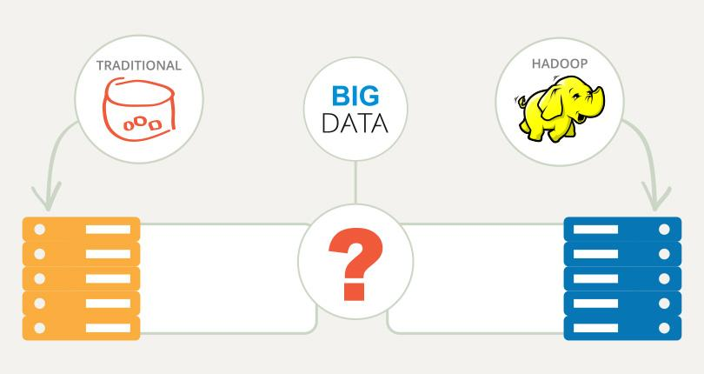
How Hadoop Improves on Traditional Databases
1. Capacity: Hadoop stores large volumes of data.
2. Speed: Hadoop stores and retrieves data faster.

Slide 54
Hadoop Core Components
01
HDFS
Big Data
02
YARN

Slide 55
H D F S

Slide 56
HDFS
Distributed File System:
Managing Data [Files, Folders across multiple servers, Computers]
DFS allow us to store data in multiple nodes or multiple machines in a cluster, multiple users can access data.
Ex: Works like File System
Windows—> NTFS [New Technology File System]
Mac —>HFS [Hierarchical File System]
NTFS, HFS Stores data in single machine
DFS Stores data in multiple machines

Slide 57
HDFS
Hadoop Cluster

Slide 58
HDFS
Data
Data
Hadoop Cluster

Slide 59
HDFS
Data
HDFS
Data
Hadoop Cluster
Data Node

Slide 60
HDFS
Advantages of Hadoop:
Distributed Storage:
Example:
10TB data stored in 10 machines
But it looks like all 10 TB data in
Single machine
HDFS
Data Node

Slide 61
HDFS
Advantages of Hadoop:
2. Distributed & Parallel Computation:
Example:
30 mins to process 1TB data in machine
Taking 1 TB Data and processing in 10 machines
1 Machine -30 mins
10 machines-? -----> 3 mins
Data Divided and processed over 10 machines parallely.

Slide 62
HDFS
Advantages of Hadoop:
3. Horizontal Scalability:
Vertical , Horizontal
Scaling
Vertical
Horizontal

Slide 63
HDFS
Advantages of Hadoop:
Vertical Scalability[Scale up]:
Increase hardware capacity of system
There is a limit to increase hardware capacity
After changing size we have to restart system
6GB
4GB
2GB

Slide 64
HDFS
Advantages of Hadoop:
Horizontal Scalability:
Add more nodes to existing cluster instead of increasing hardware capacity
We can add more machines without stopping them
At last all machines run parallel as per requirement

Slide 65
HDFS Architecture
Data Node
HDFS is Block Structured File System
Each file divided into particular size
These blocks stored across cluster one or more machines
Follow Master/ Slave Architecture
Master- Namenode
Slave - Multiple Datanodes
Datanodes can run on single machine or several machines
Data Node
Name Node
Data Node
Data Node

Slide 66
HDFS Architecture
Metadata Operations
Metadata Operations
Metadata
Namenode
Black Operations
Client
Read
Datanodes(Rack 1)
Datanodes(Rack 2)
Write
Client

Slide 67
HDFS Architecture
Functions of Namenode:
Maintain & manages Data Nodes
Records Metadata
Metadata contains 2 components
FsImage: Complete state of file system stores from start
Edit logs: All recent modifications with respect to FsImage
Records all Changes
Receives regular report of all datanodes, blocks
Also responsible for replication factor.
If Datanode fails Namenode Choose new datanode for new replicas

Slide 68
HDFS Architecture
Data Node
Metadata Operations
Metadata Operations
Metadata
Namenode
Black Operations
Client
Read
Datanodes(Rack 1)
Datanodes(Rack 2)
Write
Client

Slide 69
HDFS Architecture
Datanode:
Slave nodes in HDFS
Datanodes is Block server stores data in local file.
Functions of Datanodes:
Each run on slave machine.
Actual Data is stored in datanodes
Performs low level read & write requests from file system’s client
Send heartbeat to Namenode periodically.

Slide 70
HDFS Architecture
Secondary Namenode: [Not backup of Namenode]
Secondary Name node
Query for Edit logs in regular intervals
Name node
When Started
Update FsImage with Editlogs
Copy the updated FsImage back to Namenode
FsImage
FsImage

Slide 71
HDFS Architecture
Secondary Namenode:
Works Currently with primary namenode
Functions of Secondary Namenode:
Constantly reads all files systems & metadata from RAM of Namenode and write to hard disk or file system.
Responsible for combining edit log with FsImage from Namenode.
Secondary namenode regularly checkpoint in HDFS, So it called as Checkpoint Node

Slide 72
HDFS Architecture
Datanode, Blocks
DataNode

Slide 73
HDFS Architecture
Block:
DataNode

Slide 74
HDFS Architecture
Block:
Blocks:
Smallest continuous location on your hard drive where data stored
Default Size of Block -128MB
HDFS Stores each file as Block
DataNode

Slide 75
HDFS Architecture
Block:
Example.txt
514MB

Slide 76
HDFS Architecture
Block:
128MB
128MB
Example.txt
514MB
128MB
128MB
2MB

Slide 77
HDFS Architecture
Replication Management:
Data Blocks replicated to provide fault tolerance
Default Replication Factor 3 (We can change replication factor)
Every node having 3 times
A
C
A
B
B
C
A
B
D
E
D
E
D
C
E
Node 1
Node 2
Node 3
Node 4
Name node collects block report from datanode periodically to maintain the replication factor.
If block is over replicated or under replicated the name node deletes or add replicas as needed.

Slide 78
HDFS Architecture
Rack Awareness:
Name node takes place as all replicas not stored in same rack or single rack
It follows in-built rack awareness to reduce latency to provide fault tolerance.
First replica stored in one block and next to replicas stored in another block
A
C
A
B
B
C
D
E
D
E
D
Rack 1
Rack 2
Rack 3

Slide 79
HDFS Architecture
Hadoop Production Cluster
Multiple Racks Populated with data Node
Hadoop Cluster

Slide 80
HDFS Architecture
Hadoop Production Cluster
Multiple Racks Populated with data Node
Hadoop Cluster
. . .
Core Switch
Core Switch

Slide 81
HDFS Architecture
Hadoop Production Cluster
Multiple Racks Populated with data Node
Hadoop Cluster
. . .
Core Switch
Core Switch
Rack Switch
Rack Switch
Rack Switch
Rack Switch
Namenode
Namenode
Namenode
. . .
Namenode
Computer 1
Computer 11
Computer 21
Computer 31
Computer 2
Computer 12
Computer 22
Computer 32
. .
. .
. .
. .
Computer N
Computer N
Computer N
Computer N

Slide 82
HDFS Architecture
Advantages of Rack Awareness:
To improve Network Performance:
All racks connected with core switch, Same rack having bandwidth comparing to different rack.
To prevent loss of data:
If one rack fails but all data stored in different rack so data may not loss.

Slide 83
HDFS Architecture
HDFS follow write once read many philosophy
We can’t edit files stored in HDFS.
We can append by reopening file.
Namenode
Metadata
Black Operations
Client
Read
Datanodes(Rack 1)
Datanodes(Rack 2)
Write
Client

Slide 84
HDFS Write Architecture
Ex: Client wants to write a file “Demo.txt” with size 250MB
250MB
(Demo.txt)
128MB
+
122MB
Default Size 128MB
A–128MB
Remaining Size 122MB

Slide 85
HDFS Write Architecture
Protocols writing HDFS
Datanode
HDFS Client
Writing Request
Name Node
Datanode
Grant Write
Permission
And shares IP Address of Data nodes
Now Selection of ip address purely randomized based on availability, replication factor , rack awareness
Ex: If replication factor 3
Only replicate 3 —-> Provide 3 Ip addresses of Data nodes

Slide 86
HDFS Write Architecture
If replication factor 3
Datanode
HDFS Client
Writing Request
Name Node
Datanode
Grant Write
Permission
Datanode
Namenode provide list to client of 3 Ip address Datanodes
List will be unique for each block
Ex:
For Block A List A= {IP Address of Datanodes 1, 4, 6}
Block B List B= {IP Address of Datanodes 3, 7, 9}

Slide 87
HDFS Write Architecture
Each block copied in 3 different datanodes, to maintain replication factor.
Set up of pipeline
Data Streaming & replication
Shutdown of pipeline (Acknowledgment)
1
1
Client
Data node
Data node
Data node
3
3
3
2
2
2
Block
Block
Block

Slide 88
HDFS Write Architecture
Each block copied in 3 different datanodes, to maintain replication factor.
Set up of pipeline:
Before writing client confirm whether datanode ready to receive data or not client creates pipeline for each block by connecting data nodes
Whatever client contain that list will connect
Block A List A= {IP Address of Datanodes 1, 4, 6}
Block B List B= {IP Address of Datanodes 3, 7, 9}
Client
Namenode
Data node
Block

Slide 89
HDFS Write Architecture
Setting up HDFS Write pipeline:
Client Node
1
1 Write request for Block A
2 Send Ip Address of datanodes to client
Block
Client JVM
Client
Namenode
2
3
Core Switch
4
Switch
Rack Switch
Switch
Datanode 1
Datanode 4
Datanode 6
. .
. .
. .
Rack 1
Rack 5
Rack 7

Slide 90
HDFS Write Architecture
2. Data Streaming:
After creating pipeline client push data into pipeline, HDFS data is replicated based on replication factor
Block A stores 3 Datanodes as replication factor is 3
Datanode 4
Client
Copy
Datanode 1
Datanode 6

Slide 91
HDFS Write Architecture
2. Data Streaming:
Datanode 1 push block in pipeline data copied DN4
DN4 connect to DN6 last replica block
Client
Write Request DN1,4,6
Core Switch
Switch
Rack Switch
Switch
Datanode 1
Datanode 4
Datanode 6
Rack 1
Rack 5
Rack 7

Slide 92
HDFS Write Architecture
3. Shutdown of pipeline or Acknowledge Stage:
Once block has been copied 3 Datanodes series of Acknowledge takes place.
Acknowledgement—> Data Written Successful
Client Node
Block
Client JVM
4
Client
Namenode
Acknowledgment Datanode 6 to Datanode 4
Acknowledgment Datanode 4 to Datanode 1
Send Ack to Client
Write Successful
3
Core Switch
Switch
Rack Switch
Switch
Datanode 1
Datanode 4
1
. .
2
. .
Datanode 6
. .
Rack 1
Rack 5
Rack 7

Slide 93
HDFS Read Architecture
Client Node
Client JVM
1
Block A
Client
Read Request for Bock A,B
Send Ip Address of DN1, DN3
Reading Data from block A, B
Read from DN1, DN3
Namenode
Block B
2
4
Core Switch
3A
Switch
Rack Switch
Switch
A
B
Datanode 1
Datanode 4
A
Datanode 7
A
3B
B
Datanode 8
Datanode 5
Datanode 2
Datanode 9
Datanode 6
B
Datanode 3
B
A
Rack 1
Rack 5
Rack 7

Slide 94
Y A R N

Slide 95
YARN
Yarn- Yet Another Resource Negotiator
Map reduce performed both processing & resource management functions
Job Tracker [Single Master]
Allocated the resources
Performed Scheduling
Monitor the processing jobs
If assigned Map & Rescue task on subordinate process called Task Trackers
Task Trackers: Report their programs to job tracker
Task Tracker
Client
Client
Job Tracker
Task Tracker
Client

Slide 96
YARN
Yarn allows different data processing methods
Graph processing
Interactive processing
Stream processing
Batch processing
To run and process Data stored in HDFS

Slide 97
YARN
Hadoop 1.0
Hadoop 2.0
Map Reduce Data Processing & Resource Management
Map Reduce
Other Data Processing frameworks
YARN
Resource Manager
HDFS
HDFS

Slide 98
YARN
Yarn enable users to perform operations as per requirement
Spark → Real Time Processing
Hive → SQL
HBase → NoSQL
We can use all these in Same cluster
Yarn Performs resource management , Job Scheduling

Slide 99
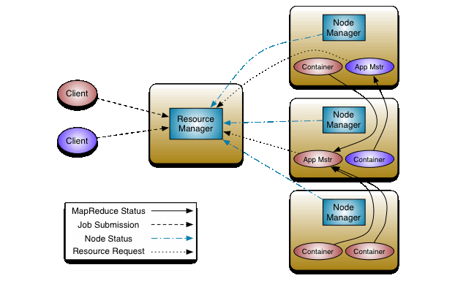
Main Components of YARN

Slide 100
Main Components of YARN
Resource Manager:
Allocate cluster resources using scheduler & Application Manager
Client
Request
Resource Manager
Pass Request
Node Manager
Check Available resources to complete applications

Slide 101
Main Components of YARN
Resource Manager:
Scheduler :
Allocate resources to various running applications
Only schedule applications so it called as pure scheduler
If any application failure scheduler not guarantee because it doesn’t track applications
This scheduling performed based on resource requirement
Pluggable Policy: Responsible for partitioning the cluster resources on various applications.

Slide 102
Main Components of YARN
Resource Manager:
Application Manager :
Responsible for accepting job submission.
Take first container from resource manager for executing applications.
Manage running application master in a cluster & provide service for restarting application master container on failure.
Resource manager optimize cluster utilization like keeping all resources in use.

Slide 103
Main Components of YARN
2. Node Manager:
Takes care of all individual nodes in a cluster and manages user jobs
Primary goal to manage application containers assigned by resource manager
Assign Containers
Node
Resource Manager
Node Manager
Node
Report of nodes
Node

Slide 104
Main Components of YARN
2. Node Manager:
Application Master requests the assigned container from the Node Manager by sending it a Container Launch Context(CLC)
Node manager creates requested container process and starts it
Perform log management
1`t kills container as directed by resource manager

Slide 105
Main Components of YARN
3. Application Master:
Application Master is a Single Job submitted to framework
Every Application have a unique application master associated with framework
Manage faults in applications execution in cluster
Main Tasks:
Negotiate resources from Resource manager and works with node manager & monitor tasks
Its should take appropriate containers from Resource Manager
Track & monitor containers status
Updates pass to resource manager

Slide 106
Main Components of YARN
4. Container:
Collection of physical resources[RAM, CPU, Disks on Single node]
Yarn containers managed by CLC(Container Launch Context or Container Life Cycle)
CLC contains map of environment variable dependencies stored in remotely accessible storage, Security tokens, Payloads for Node manager.
Grant rights to application to use specific amount of resources on specific host

Slide 107
Application submission steps in YARN
1,3
Resource manager node
Client Node
Resource Manager
MR
Code
MR
Job
Submit the Job
Get Application ID
Application submission context
(a) Start Container launch
(b) Launch Application Master
Allocate Resources
(a) Container
(b) Launch
Execute
2
4-b
Node Manager
Node Manager
5
Task JVM
6-b
4-a
YARN Child
App Master JVM
6-a
7
MR Task

Slide 108
Application Workflow of YARN
Client
Resource Manager
Node Manager
Application Manager
1
2
3
4
5
6
7
8

Slide 109
Application Workflow of YARN
Client submit an application
Resource Manager allocates a container to start application manager
Application manager register with resource manager
Application manager ask container from resource manager
Application manager notifies Node manager to launch containers
Application code executed in container
Client contact resource manager [Application manager to monitor application status]
Application manager unregister with resource manager

Slide 110
Hadoop Ecosystem
01
HDFS
02
YARN
Big Data
03
Map Reduce
04
Apache Pig, Apache Spark, Hive
05
Other Tools of Hadoop

Slide 111
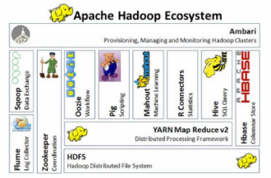
Hadoop Ecosystem
Hadoop is is a platform with various integral components that enable distributed data storage and processing.
These components together form the Hadoop ecosystem.

Slide 112
Hadoop Core Components
HDFS
MapReduce
YARN
Hive
Apache Pig
Apache HBase
Sqoop,
Apache Flume
Apache Drill
Apache Mahout
Zookeeper

Slide 113
H D F S

Slide 114
HDFS
Distributed File System:
Managing Data [Files, Folders across multiple servers, Computers]
DFS allow us to store data in multiple nodes or multiple machines in a cluster, multiple users can access data.
Ex: Works like File System
Windows—> NTFS [New Technology File System]
Mac —>HFS [Hierarchical File System]
NTFS, HFS Stores data in single machine
DFS Stores data in multiple machines

Slide 115
HDFS
Hadoop Cluster

Slide 116
HDFS
Data
Data
Hadoop Cluster

Slide 117
HDFS
Data
HDFS
Data
Hadoop Cluster
Data Node

Slide 118
HDFS
Advantages of Hadoop:
Distributed Storage:
Example:
10TB data stored in 10 machines
But it looks like all 10 TB data in
Single machine
HDFS
Data Node

Slide 119
HDFS
Advantages of Hadoop:
2. Distributed & Parallel Computation:
Example:
30 mins to process 1TB data in machine
Taking 1 TB Data and processing in 10 machines
1 Machine -30 mins
10 machines-? -----> 3 mins
Data Divided and processed over 10 machines parallely.

Slide 120
HDFS
Advantages of Hadoop:
3. Horizontal Scalability:
Vertical , Horizontal
Scaling
Vertical
Horizontal

Slide 121
HDFS
Advantages of Hadoop:
Vertical Scalability[Scale up]:
Increase hardware capacity of system
There is a limit to increase hardware capacity
After changing size we have to restart system
6GB
4GB
2GB

Slide 122
HDFS
Advantages of Hadoop:
Horizontal Scalability:
Add more nodes to existing cluster instead of increasing hardware capacity
We can add more machines without stopping them
At last all machines run parallel as per requirement

Slide 123
HDFS Architecture
Data Node
HDFS is Block Structured File System
Each file divided into particular size
These blocks stored across cluster one or more machines
Follow Master/ Slave Architecture
Master- Namenode
Slave - Multiple Datanodes
Datanodes can run on single machine or several machines
Data Node
Name Node
Data Node
Data Node

Slide 124
HDFS Architecture
Name Node
Metadata Operations
Metadata Operations
Metadata
Namenode
Black Operations
Client
Read
Datanodes(Rack 1)
Datanodes(Rack 2)
Write
Client

Slide 125
HDFS Architecture
Functions of Namenode:
Maintain & manages Data Nodes
Records Metadata
Metadata contains 2 components
FsImage: Complete state of file system stores from start
Edit logs: All recent modifications with respect to FsImage
Records all Changes
Receives regular report of all datanodes, blocks
Also responsible for replication factor.
If Datanode fails Namenode Choose new datanode for new replicas

Slide 126
HDFS Architecture
Data Node
Metadata Operations
Metadata Operations
Metadata
Namenode
Black Operations
Client
Read
Datanodes(Rack 1)
Datanodes(Rack 2)
Write
Client

Slide 127
HDFS Architecture
Datanode:
Slave nodes in HDFS
Datanodes is Block server stores data in local file.
Functions of Datanodes:
Each run on slave machine.
Actual Data is stored in datanodes
Performs low level read & write requests from file system’s client
Send heartbeat to Namenode periodically.

Slide 128
HDFS Architecture
Secondary Namenode: [Not backup of Namenode]
Secondary Name node
Query for Edit logs in regular intervals
Name node
When Started
Update FsImage with Editlogs
Copy the updated FsImage back to Namenode
FsImage
FsImage

Slide 129
HDFS Architecture
Secondary Namenode:
Works Currently with primary namenode
Functions of Secondary Namenode:
Constantly reads all files systems & metadata from RAM of Namenode and write to hard disk or file system.
Responsible for combining edit log with FsImage from Namenode.
Secondary namenode regularly checkpoint in HDFS, So it called as Checkpoint Node

Slide 130
HDFS Architecture
Datanode, Blocks
DataNode

Slide 131
HDFS Architecture
Block:
DataNode

Slide 132
HDFS Architecture
Block:
Blocks:
Smallest continuous location on your hard drive where data stored
Default Size of Block -128MB
HDFS Stores each file as Block
DataNode

Slide 133
HDFS Architecture
Block:
Example.txt
514MB

Slide 134
HDFS Architecture
Block:
128MB
128MB
Example.txt
514MB
128MB
128MB
2MB

Slide 135
HDFS Architecture
Replication Management:
Data Blocks replicated to provide fault tolerance
Default Replication Factor 3 (We can change replication factor)
Every node having 3 times
A
C
A
B
B
C
A
B
D
E
D
E
D
C
E
Node 1
Node 2
Node 3
Node 4
Name node collects block report from datanode periodically to maintain the replication factor.
If block is over replicated or under replicated the name node deletes or add replicas as needed.

Slide 136
HDFS Architecture
Rack Awareness:
Name node takes place as all replicas not stored in same rack or single rack
It follows in-built rack awareness to reduce latency to provide fault tolerance.
First replica stored in one block and next to replicas stored in another block
A
C
A
B
B
C
D
E
D
E
D
Rack 1
Rack 2
Rack 3

Slide 137
HDFS Architecture
Hadoop Production Cluster
Multiple Racks Populated with data Node
Hadoop Cluster

Slide 138
HDFS Architecture
Hadoop Production Cluster
Multiple Racks Populated with data Node
Hadoop Cluster
. . .
Core Switch
Core Switch

Slide 139
HDFS Architecture
Hadoop Production Cluster
Multiple Racks Populated with data Node
Hadoop Cluster
. . .
Core Switch
Core Switch
Rack Switch
Rack Switch
Rack Switch
Rack Switch
Namenode
Namenode
Namenode
. . .
Namenode
Computer 1
Computer 11
Computer 21
Computer 31
Computer 2
Computer 12
Computer 22
Computer 32
. .
. .
. .
. .
Computer N
Computer N
Computer N
Computer N

Slide 140
HDFS Architecture
Advantages of Rack Awareness:
To improve Network Performance:
All racks connected with core switch, Same rack having bandwidth comparing to different rack.
To prevent loss of data:
If one rack fails but all data stored in different rack so data may not loss.

Slide 141
HDFS Read/Write Architecture
HDFS follow write once read many philosophy
We can’t edit files stored in HDFS.
We can append by reopening file.
Namenode
Metadata
Black Operations
Client
Read
Datanodes(Rack 1)
Datanodes(Rack 2)
Write
Client

Slide 142
HDFS Write Architecture
Ex: Client wants to write a file “Demo.txt” with size 250MB
250MB
(Demo.txt)
128MB
+
122MB
Default Size 128MB
A–128MB
Remaining Size 122MB

Slide 143
HDFS Write Architecture
Protocols writing HDFS
Datanode
HDFS Client
Writing Request
Name Node
Datanode
Grant Write
Permission
And shares IP Address of Data nodes
Now Selection of ip address purely randomized based on availability, replication factor , rack awareness
Ex: If replication factor 3
Only replicate 3 —-> Provide 3 Ip addresses of Data nodes

Slide 144
HDFS Write Architecture
If replication factor 3
Datanode
HDFS Client
Writing Request
Name Node
Datanode
Grant Write
Permission
Datanode
Namenode provide list to client of 3 Ip address Datanodes
List will be unique for each block
Ex:
For Block A List A= {IP Address of Datanodes 1, 4, 6}
Block B List B= {IP Address of Datanodes 3, 7, 9}

Slide 145
HDFS Write Architecture
Each block copied in 3 different datanodes, to maintain replication factor.
Set up of pipeline
Data Streaming & replication
Shutdown of pipeline (Acknowledgment)
1
1
Client
Data node
Data node
Data node
3
3
3
2
2
2
Block
Block
Block

Slide 146
HDFS Write Architecture
Each block copied in 3 different datanodes, to maintain replication factor.
Set up of pipeline:
Before writing client confirm whether datanode ready to receive data or not client creates pipeline for each block by connecting data nodes
Whatever client contain that list will connect
Block A List A= {IP Address of Datanodes 1, 4, 6}
Block B List B= {IP Address of Datanodes 3, 7, 9}
Client
Namenode
Data node
Block

Slide 147
HDFS Write Architecture
Setting up HDFS Write pipeline:
Client Node
1
1 Write request for Block A
2 Send Ip Address of datanodes to client
Block
Client JVM
Client
Namenode
2
3
Core Switch
4
Switch
Rack Switch
Switch
Datanode 1
Datanode 4
Datanode 6
. .
. .
. .
Rack 1
Rack 5
Rack 7

Slide 148
HDFS Write Architecture
2. Data Streaming:
After creating pipeline client push data into pipeline, HDFS data is replicated based on replication factor
Block A stores 3 Datanodes as replication factor is 3
Datanode 4
Client
Copy
Datanode 1
Datanode 6

Slide 149
HDFS Write Architecture
2. Data Streaming:
Datanode 1 push block in pipeline data copied DN4
DN4 connect to DN6 last replica block
Client
Write Request DN1,4,6
Core Switch
Switch
Rack Switch
Switch
Datanode 1
Datanode 4
Datanode 6
Rack 1
Rack 5
Rack 7

Slide 150
HDFS Write Architecture
3. Shutdown of pipeline or Acknowledge Stage:
Once block has been copied 3 Datanodes series of Acknowledge takes place.
Acknowledgement—> Data Written Successful
Client Node
Block
Client JVM
4
Client
Namenode
Acknowledgment Datanode 6 to Datanode 4
Acknowledgment Datanode 4 to Datanode 1
Send Ack to Client
Write Successful
3
Core Switch
Switch
Rack Switch
Switch
Datanode 1
Datanode 4
1
. .
2
. .
Datanode 6
. .
Rack 1
Rack 5
Rack 7

Slide 151
HDFS Read Architecture
Client Node
Client JVM
1
Block A
Client
Read Request for Bock A,B
Send Ip Address of DN1, DN3
Reading Data from block A, B
Read from DN1, DN3
Namenode
Block B
2
4
Core Switch
3A
Switch
Rack Switch
Switch
A
B
Datanode 1
Datanode 4
A
Datanode 7
A
3B
B
Datanode 8
Datanode 5
Datanode 2
Datanode 9
Datanode 6
B
Datanode 3
B
A
Rack 1
Rack 5
Rack 7

Slide 152
Y A R N

Slide 153
YARN
Yarn- Yet Another Resource Negotiator
Map reduce performed both processing & resource management functions
Job Tracker [Single Master]
Allocated the resources
Performed Scheduling
Monitor the processing jobs
If assigned Map & Rescue task on subordinate process called Task Trackers
Task Trackers: Report their programs to job tracker
Task Tracker
Client
Client
Job Tracker
Task Tracker
Client

Slide 154
YARN
Yarn allows different data processing methods
Graph processing
Interactive processing
Stream processing
Batch processing
To run and process Data stored in HDFS

Slide 155
YARN
Hadoop 1.0
Hadoop 2.0
Map Reduce Data Processing & Resource Management
Map Reduce
Other Data Processing frameworks
YARN
Resource Manager
HDFS
HDFS

Slide 156
YARN
Yarn enable users to perform operations as per requirement
Spark → Real Time Processing
Hive → SQL
HBase → NoSQL
We can use all these in Same cluster
Yarn Performs resource management , Job Scheduling

Slide 157
Main Components of YARN

Slide 158
Main Components of YARN
Resource Manager:
Allocate cluster resources using scheduler & Application Manager
Client
Request
Resource Manager
Pass Request
Node Manager
Check Available resources to complete applications

Slide 159
Main Components of YARN
Resource Manager:
Scheduler :
Allocate resources to various running applications
Only schedule applications so it called as pure scheduler
If any application failure scheduler not guarantee because it doesn’t track applications
This scheduling performed based on resource requirement
Pluggable Policy: Responsible for partitioning the cluster resources on various applications.

Slide 160
Main Components of YARN
Resource Manager:
Application Manager :
Responsible for accepting job submission.
Take first container from resource manager for executing applications.
Manage running application master in a cluster & provide service for restarting application master container on failure.
Resource manager optimize cluster utilization like keeping all resources in use.

Slide 161
Main Components of YARN
2. Node Manager:
Takes care of all individual nodes in a cluster and manages user jobs
Primary goal to manage application containers assigned by resource manager
Assign Containers
Node
Resource Manager
Node Manager
Node
Report of nodes
Node

Slide 162
Main Components of YARN
2. Node Manager:
Application Master requests the assigned container from the Node Manager by sending it a Container Launch Context(CLC)
Node manager creates requested container process and starts it
Perform log management
1`t kills container as directed by resource manager

Slide 163
Main Components of YARN
3. Application Master:
Application Master is a Single Job submitted to framework
Every Application have a unique application master associated with framework
Manage faults in applications execution in cluster
Main Tasks:
Negotiate resources from Resource manager and works with node manager & monitor tasks
Its should take appropriate containers from Resource Manager
Track & monitor containers status
Updates pass to resource manager

Slide 164
Main Components of YARN
4. Container:
Collection of physical resources[RAM, CPU, Disks on Single node]
Yarn containers managed by CLC(Container Launch Context or Container Life Cycle)
CLC contains map of environment variable dependencies stored in remotely accessible storage, Security tokens, Payloads for Node manager.
Grant rights to application to use specific amount of resources on specific host

Slide 165
Application submission steps in YARN
1,3
Resource manager node
Client Node
Resource Manager
MR
Code
MR
Job
Submit the Job
Get Application ID
Application submission context
(a) Start Container launch
(b) Launch Application Master
Allocate Resources
(a) Container
(b) Launch
Execute
2
4-b
Node Manager
Node Manager
5
Task JVM
6-b
4-a
YARN Child
App Master JVM
6-a
7
MR Task

Slide 166
Application Workflow of YARN
Client
Resource Manager
Node Manager
Application Manager
1
2
3
4
5
6
7
8

Slide 167
Application Workflow of YARN
Client submit an application
Resource Manager allocates a container to start application manager
Application manager register with resource manager
Application manager ask container from resource manager
Application manager notifies Node manager to launch containers
Application code executed in container
Client contact resource manager [Application manager to monitor application status]
Application manager unregister with resource manager

Slide 168
Map Reduce

Slide 169
Map Reduce
Core building block of processing in hadoop.
Traditional Way:
Very Big Data

Slide 170
Map Reduce
Core building block of processing in hadoop.
Traditional Way:
Split data
Very Big Data
Split data
Split data
Split data

Slide 171
Map Reduce
Core building block of processing in hadoop.
Traditional Way:
Split data
Matches
Very Big Data
Split data
Matches
Split data
Matches
Split data
Matches

Slide 172
Map Reduce
Core building block of processing in hadoop.
Traditional Way:
Split data
Matches
Very Big Data
All Matches
Split data
Matches
Split data
Matches
Split data
Matches

Slide 173
Map Reduce
Example:
2000-2015 Weather Report
Qn: Find Highest Temperature day in year
Split data
Matches
Very Big Data
All Matches
Split data
Matches
Split data
Matches
Split data
Matches

Slide 174
Map Reduce
Challenges with traditional way:
Critical Path Problem:
Time Delay [Time to take to complete job]
Reliability problem:
If any machine worked on any fail management of failure become challenge.
Equal Split issue:
Each machine gets equal parts of data. Sometimes machines overloaded or underloaded.
The single split may fail:
If one machine fails to provide output we can’t calculate result
Aggregate of Result:
To aggregate final result generated by each machine to produce final output.

Slide 175
MapReduce in Detail
Map()
Input
Reduce
Map()
Output
Map()
Reduce
Map()
Map Reduce:
Perform Distributed & parallel processing on large data.
Map Reduce: 2 Taks Map, Reduce

Slide 176
MapReduce in Detail
Data

Slide 177
MapReduce in Detail
Map()
Data
Map()
Map()
Map()

Slide 178
MapReduce in Detail
Map()
Key/Value Pairs
Data
Map()
Key/Value Pairs
Map()
Key/Value Pairs
Map()
Key/Value Pairs

Slide 179
MapReduce in Detail
Map()
Key/Value Pairs
Data
Reduce
Map()
Key/Value Pairs
Map()
Key/Value Pairs
Reduce
Map()
Key/Value Pairs

Slide 180
MapReduce in Detail
Map()
Key/Value Pairs
Data
Reduce
Map()
Key/Value Pairs
Set of Tuples
Map()
Key/Value Pairs
Reduce
Map()
Key/Value Pairs

Slide 181
MapReduce in Detail
Map()
Key/Value Pairs
Data
Reduce
Map()
Key/Value Pairs
Set of Tuples
Output
Map()
Key/Value Pairs
Reduce
Map()
Key/Value Pairs

Slide 182

MapReduce in Detail
Mapper Class():
First stage in Data processing
Input Records
Record
Reader
Key value pair

Slide 183
MapReduce in Detail
Input Split
It is the logical representation of data.
It represents a block of work that contains a single map task in the MapReduce Program.
RecordReader
It interacts with the Input split and converts the obtained data in the form of Key-Value Pairs.
Input Records
Record
Reader
Convert
Key- Value Pairs
Interact

Slide 184
MapReduce in Detail
Reducer Class():
First stage in Data processing
Intermediate Key Value pairs from map
Reducer
Final Output
HDFS

Slide 185
MapReduce in Detail
Driver Class():
Major Component of Map Reduce
Set Mapreduce job to run in hadoop
We specify all data related to Mapper & reducer

Slide 186
MapReduce in Detail
Example: Word Count using Mapreduce
Text File —--> Rose, lilly, lotus, lilly, Rose, Red,lotus,Rose,Red
Goal: Perform Word Count on Text File
Text File

Slide 187
MapReduce in Detail
Example: Word Count using Mapreduce
Text File —--> Rose, lilly, lotus, lilly, Rose, Red,lotus,Rose,Red
Goal: Perform Word Count on Text File
Rose, lilly, lotus
Text File
lilly, Rose, Rose
lotus,Red,Red

Slide 188
MapReduce in Detail
Example: Word Count using Mapreduce
Text File —--> Rose, lilly, lotus, lilly, Rose, Red,lotus,Rose,Red
Goal: Perform Word Count on Text File
Rose 1
Lilly 1
Lotus 1
Rose, lilly, lotus
Text File
lilly, Rose, Rose
Lilly 1
Rose 2
lotus,Red,Red
Lotus 1
Red 2

Slide 189
MapReduce in Detail
Example: Word Count using Mapreduce
Text File —--> Rose, lilly, lotus, lilly, Rose, Red,lotus,Rose,Red
Goal: Perform Word Count on Text File
Rose(1,2)
Rose 1
Lilly 1
Lotus 1
Rose, lilly, lotus
Lilly (1,1)
Text File
lilly, Rose, Rose
Lilly 1
Rose 2
Lotus(1,1)
lotus,Red,Red
Lotus 1
Red 2
Red (2)

Slide 190
MapReduce in Detail
Example: Word Count using Mapreduce
Text File —--> Rose, lilly, lotus, lilly, Rose, Red,lotus,Rose,Red
Goal: Perform Word Count on Text File
Rose(1,2)
Rose (3)
Rose 1
Lilly 1
Lotus 1
Rose, lilly, lotus
Lilly (1,1)
Lilly (2)
Text File
lilly, Rose, Rose
Lilly 1
Rose 2
Lotus(1,1)
Lotus(2)
lotus,Red,Red
Lotus 1
Red 2
Red (2)
Red (2)

Slide 191
MapReduce in Detail
Example: Word Count using Mapreduce
Text File —--> Rose, lilly, lotus, lilly, Rose, Red,lotus,Rose,Red
Goal: Perform Word Count on Text File
Rose(1,2)
Rose (3)
Rose 1
Lilly 1
Lotus 1
Rose, lilly, lotus
Lilly (1,1)
Lilly (2)
Rose 3
Lilly 2
Lotus 2
Red 2
Text File
lilly, Rose, Rose
Lilly 1
Rose 2
Lotus(1,1)
Lotus(2)
lotus,Red,Red
Lotus 1
Red 2
Red (2)
Red (2)

Slide 192
Advantages of MapReduce
Parallel Processing:
Dividing job along multiple nodes
Mapreduce based on divide and conquer method it helps process data on different machines
Data running on different machines instead of single machine it won’t take much time.
1
Job
2
3

Slide 193
Advantages of MapReduce
Difference Between Traditional & Map Reduce
Moving Data to Processing Unit (Traditional)
Moving Processing Unit to Data (Mapreduce)
Slave
Slave
Master
Master
Slave
Slave
Slave
Slave

Slide 194
Advantages of MapReduce
2. Data Locality:
Huge Data cannot bring to processing unit
Moving Data to Processing Unit (Traditional)
Moving Processing Unit to Data (Mapreduce)
Slave
Slave
Master
Master
Slave
Slave
Slave
Slave

Slide 195
Advantages of MapReduce
2. Data Locality:
Issues with processing unit
Moving data to processing unit is costly it damage network performance
Processing takes time if data processed by single unit
Master node can get burdened may fail

Slide 196
Advantages of MapReduce
2. Data Locality:
Mapreduce Overcome these issues:
Data distributed among multiple nodes. Each node process the part of data
Advantages:
Cost Effective to move processing unit to data
Processing time reduce as all nodes working
Every node get part of data no chance to overburdened

Slide 197

A P A C H E
P I G

Slide 198
APACHE PIG
10 lines of pig code= 200 lines of mapreduce code
Mapreduce written in java
Pig is not related to python or java
It is easy to learn
Pig is 2 parts
Pig Latin →Language[Like SQL]
Pig runtime→ Every backend of pig job mapreduce job executes
Compiler internally convert pig latin to mapreduce
Pig Developed by Yahoo
It gives platform for building data flow for ETL (Extract, Transform, Load) Processing & analysing huge datasets

Slide 199
APACHE PIG
How Pig Works:
Load Commands, Load Data
Store results in HDFS
Perform various functions
HDFS
Grouping, Filtering,
Joining, Sorting
We can use pig for huge data, streaming, online data
We can use for data processing for search platforms
We can use to process sensitive data

Slide 200


Slide 201
APACHE HIVE
Facebook created hive
Hive written in SQL
Easy with Hive while working in hadoop
What is HIVE?
Data warehouse component
Performs Reading,Writing, Managing large datasets in distributed environment using SQL-like interface.
HIVE + SQL = HQL [Hive Query Language]

Slide 202
APACHE HIVE
HIVE have 2 components:
HIVE Command Line
JDBC/ ODBC Driver– Used to establish connection from database storage
JDBC→ Java Database Connectivity
ODBC→ Object Database Connectivity
Hive is highly scalable
It can serve for large datasets processing (Batch Query Processing)& Real time processing (Intermediate Query Processing)

Slide 203


Slide 204

APACHE SPARK
Framework for real time processing data analytics in a distributed computing
Spark written in scala
Executes in memory computation to increase speed of data processing over mapreduce
It is 100x faster because of In-memory computation while comparing hadoop
Spark is pack of all libraries -R, SQL, Python, Scala,Java, Spark SQL+Dataframes,Streaming, MiLib, GraphX

Slide 205
APACHE SPARK
Q) Apache Spark Killer or Saviour of Hadoop
Spark→ Real time processing
Hadoop→ Designed to store unstructured data and processing over it.
Spark Features + Hadoop Features = Low cost Hardware
So this reason so many companies using these technologies together.

Slide 206


Slide 207
APACHE HBASE
Open Source, Non relational distributed database, NoSQL database.
Support all types of data
Capable to handle anything in hadoop
Modelled after google big table (Distributed Storage System)
HBase was designed to run on top of HDFS
It store small data without fault.
HBase written in java
Ex: Email –Billions of users

Slide 208


Slide 209

APACHE DRILL
Drill to any kind of data
Open source application worked on distributed environment to analyze large datasets
Replica of Google Dremel
Support NoSQL database, File Systems
Ex: Azure Blob Storage, Google Cloud Storage, HBase, MongoDB, MapR-DB HDFS, MapR-FS, Amazon S3, Swift, NAS and local files.
Drill Scalable
We can process petabytes, exabytes of data in minutes
Combine various data stores just by single Query.
Follow ANSI SQL
Powerful scalability factor, serve their query request’s over large data

Slide 210


Slide 211
APACHE ZOOKEEPER
Coordinates of any hadoop job
Coordinates with various services
To coordinate before zookeeper it is time consuming
Services earlier we have so many issues like common configurations (Services with same names)
Grouping & Naming also time consuming factor
Main Goals:
Synchronization
Configuration
Maintenance
Grouping
Naming

Slide 212


Slide 213
APACHE OOZIE
Clock & Alarm service inside hadoop for apache jobs. Oozie is like scheduler
It schedules hadoop jobs and binds them together as on logical work.
2 OOzie Jobs:
Oozie workflow:
Sequence set of actions to executed assume it to relay race
Oozie Coordinator:
Jobs triggered when data is made available

Slide 214


Slide 215
APACHE FLUME
Ingesting Data is an important art of hadoop
Flume helps in ingesting unstructured , semi structured data into HDFS
It helps in collecting, aggregating, moving large datasets
Ingest online streaming data from various sources like network traffic social media, email, msgs in HDFS

Slide 216
APACHE FLUME
Web Server
Source
Sink
HDFS
Channel
Flume Agent
Flume Agent: Ingests streaming Data from various sources to HDFS
It have 3 components
Source: Accept Data from incoming stream line & stores in channel
Channel: Local Storage or primary storage, Channel is temporary storage between source data & persisted HDFS data
Sink: Collects data from channel & commits or writes the data in HDFS

Slide 217

SQOOP

Slide 218
APACHE SQOOP
Data ingest service
Major Difference between Flume & Sqoop:
Flume only ingest Unstructured, Semi-structured data into HDFS
SQOOP can import as well as export structured data from RDBMS or Enterprise data warehouse to HDFS (vice versa)

Slide 219
APACHE SQOOP
When we submit Sqoop command, our main task gets divided into sub tasks which is handled by individual Map Task internally. Map Task is the sub task, which imports part of data to the Hadoop Ecosystem. Collectively, all Map tasks imports the whole data.
Enterprise data warehouse
Document based system
Command
Relational DB
Web Server
Map Task
HDFS / Hive/ Hbase
Hadoop

Slide 220


APACHE SQOOP
2
Sqoop Export
Sqoop job HDFS Storage
1 Gather Metadata
2. Submit map only job
1
Map()
Map()
Map()
Map()
Hadoop Cluster

Slide 221


Slide 222
APACHE MAHOUT
Renowned for Machine Learning
Provides environment for creating machine learning applications
Mahout performs
Collaborative filtering:
Mines user behaviour,pattern, character based on this predicts and make recommendations to users
Ex : E-commerce Websites
Clustering:
Organize similar group of data together
Ex: Blogs, Articles, News
Classifier:
Classifying and categorizing data
Frequent item set missing:
Which object likely appearing & make suggestions, if they are missing.
Ex: Search for Mobile, suggests back cases

Slide 223
THANK YOU

